Slide 1
Chapter 3: The Negotiation Clock Face
Strategic Negotiation Frameworks for Business Administration Students
CHAPTER OPENING EPIGRAPH:
“There is no right, no wrong, no good, and no bad way to negotiate.
Only that which is appropriate to your circumstances.”
— Steve Gates, The Negotiation Book (3rd Edition)
Based on 'The Negotiation Book' by Steve Gates | Academic Presentation for Business Students

Slide 2
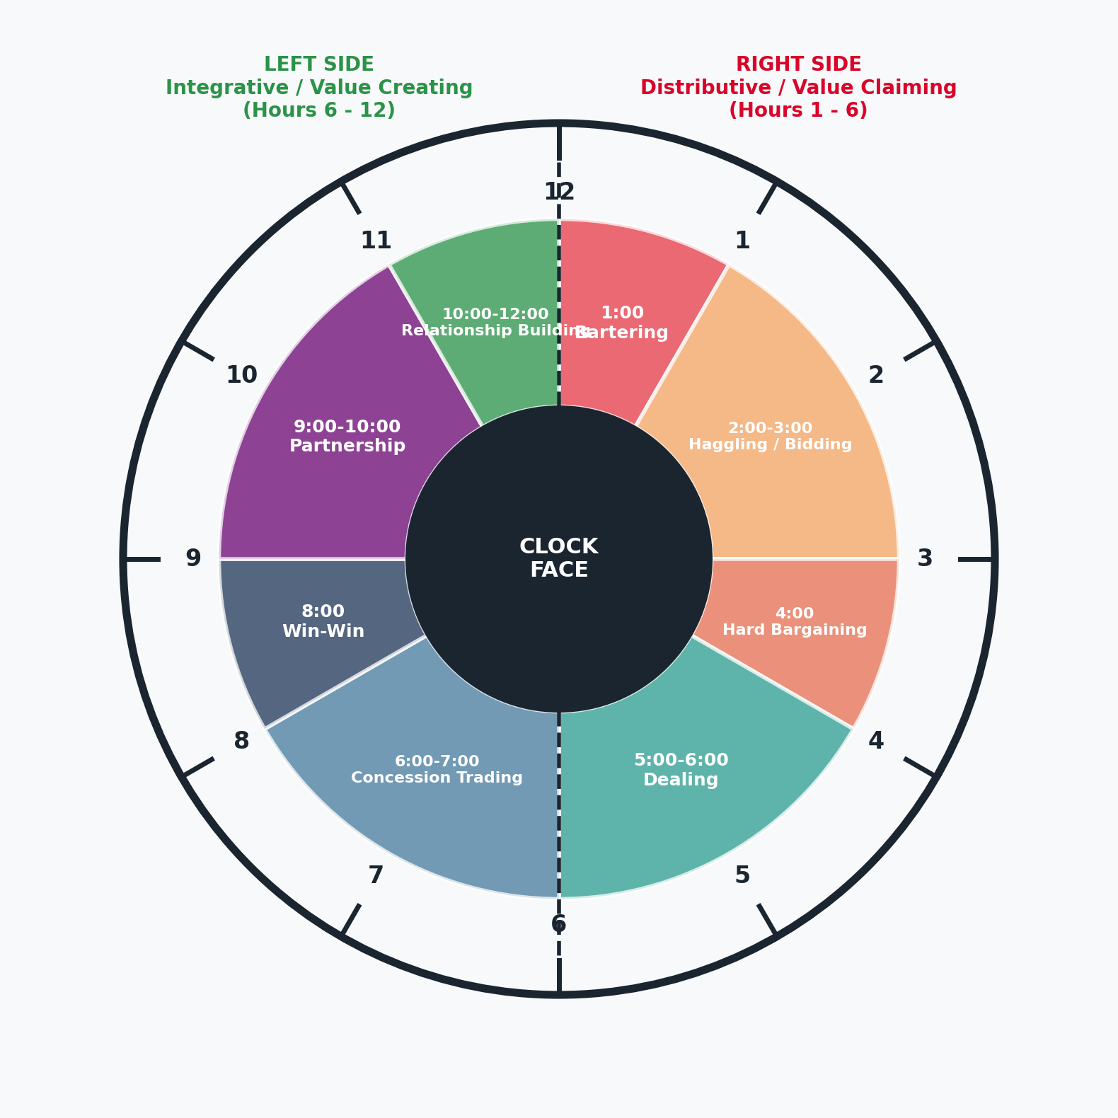
CHAPTER 3: THE NEGOTIATION CLOCK FACE
The Negotiation Clock Face as a Strategic Compass
RIGHT SIDE (Hours 1:00 - 6:00)
• Focus: Distributive bargaining / value claiming (finite pie)
• Climate: Transactional, lower trust, positional & tough
• Key Hours: Bartering (1:00), Bidding (2:00-3:00), Hard Bargaining (4:00), Dealing (5:00-6:00)
LEFT SIDE (Hours 6:00 - 12:00)
• Focus: Integrative bargaining / value creation (expanding pie)
• Climate: Collaborative, higher trust, strategic interdependence
• Key Hours: Concession Trading (6:00-7:00), Win-Win (8:00), Partnership (9:00-10:00), Relationship (10:00-12:00)

Slide 3
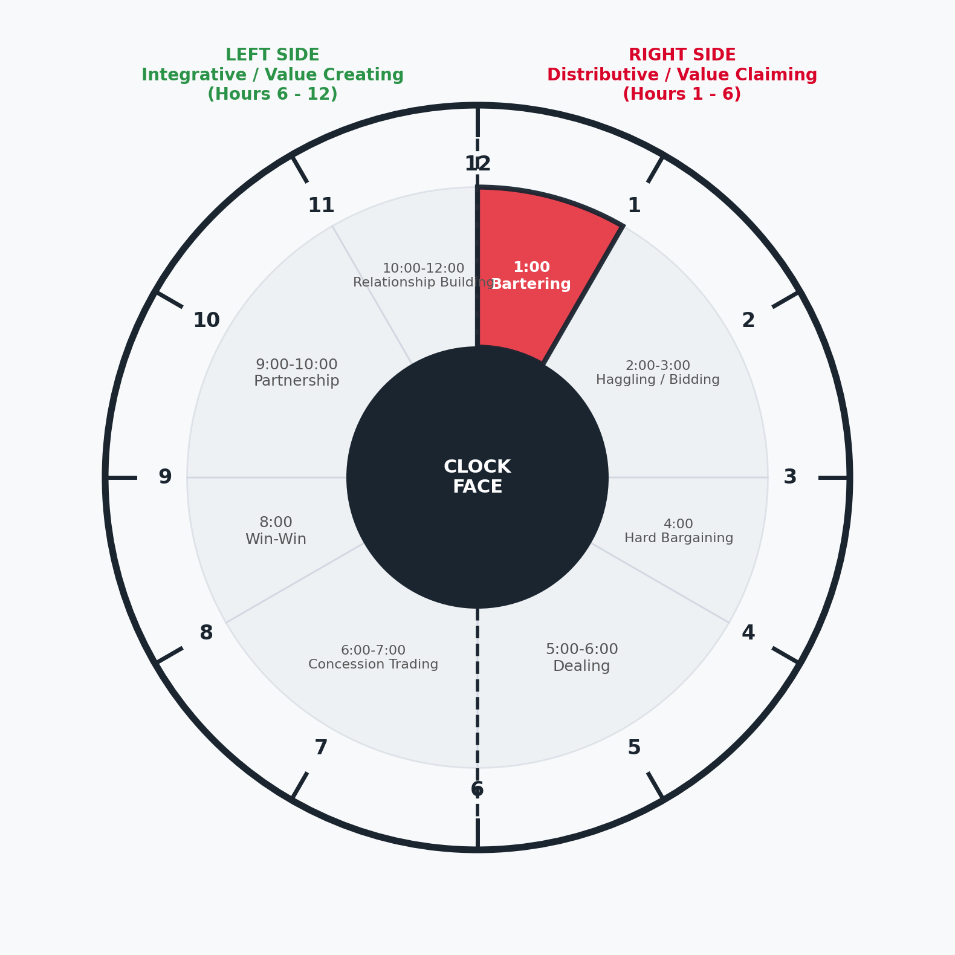
CHAPTER 3: THE NEGOTIATION CLOCK FACE
Hour 1:00 — Bartering (Direct Asset Exchange)
Key Characteristics & Strategic Action
► Hour Definition & Action: Direct exchange of goods or services without currency. Represents the most primitive, basic form of value trade at 1:00.
► Business Context: Used in corporate countertrade, asset swaps between firms, and international trade agreements where liquidity is restricted.
► Negotiation Behavior: Transactional valuation item-for-item without financing mechanisms or complex interest structures.
► Strategic Insight: Valuation is purely subjective based on immediate operational utility to both entities.

Slide 4
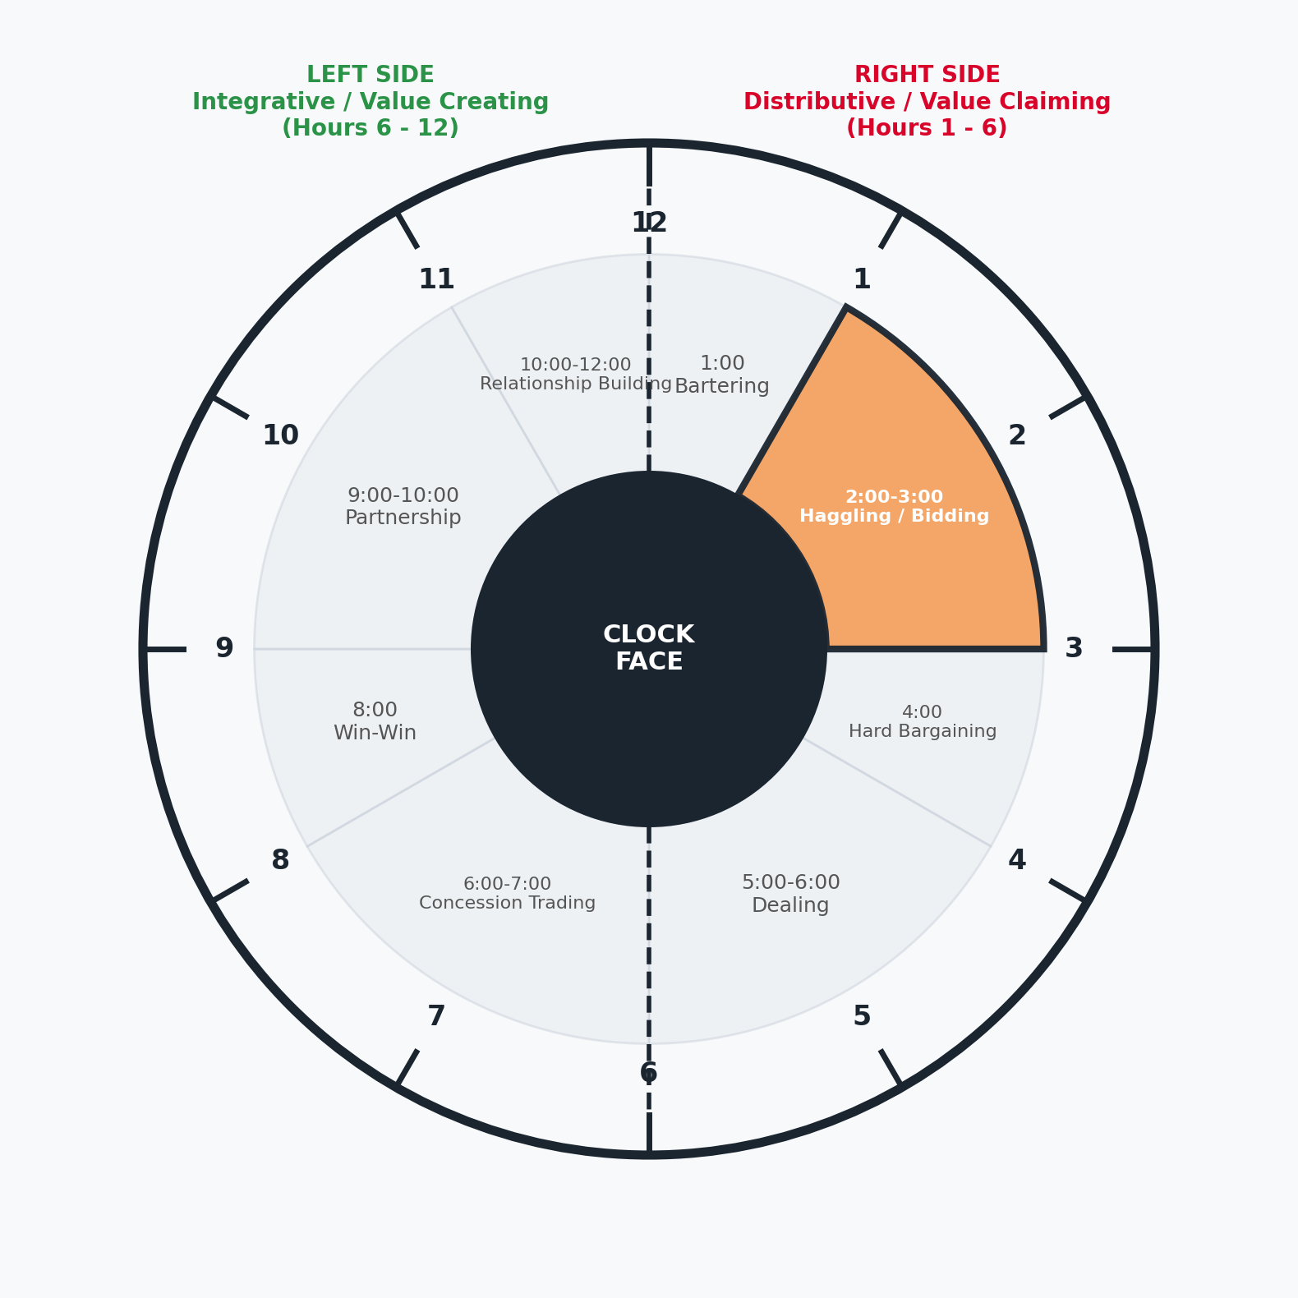
CHAPTER 3: THE NEGOTIATION CLOCK FACE
Hours 2:00–3:00 — Haggling & Bidding (Market-Driven Pricing)
Key Characteristics & Strategic Action
► Hour Definition & Action: Price discovery and value allocation governed strictly by market supply and demand forces.
► Key Mechanisms: Online e-auctions, stock market bidding, flight seat upgrade bids, and corporate RFP/tender briefing processes.
► Two-Stage Business Process: Procurement teams use 2–3 o'clock tenders to screen suppliers, then shift to 8 o'clock for integrative value creation with finalists.
► Strategic Caution: Avoid 'Winner's Curse' where aggressive competitive bidding drives contract prices beyond commercial viability.

Slide 5
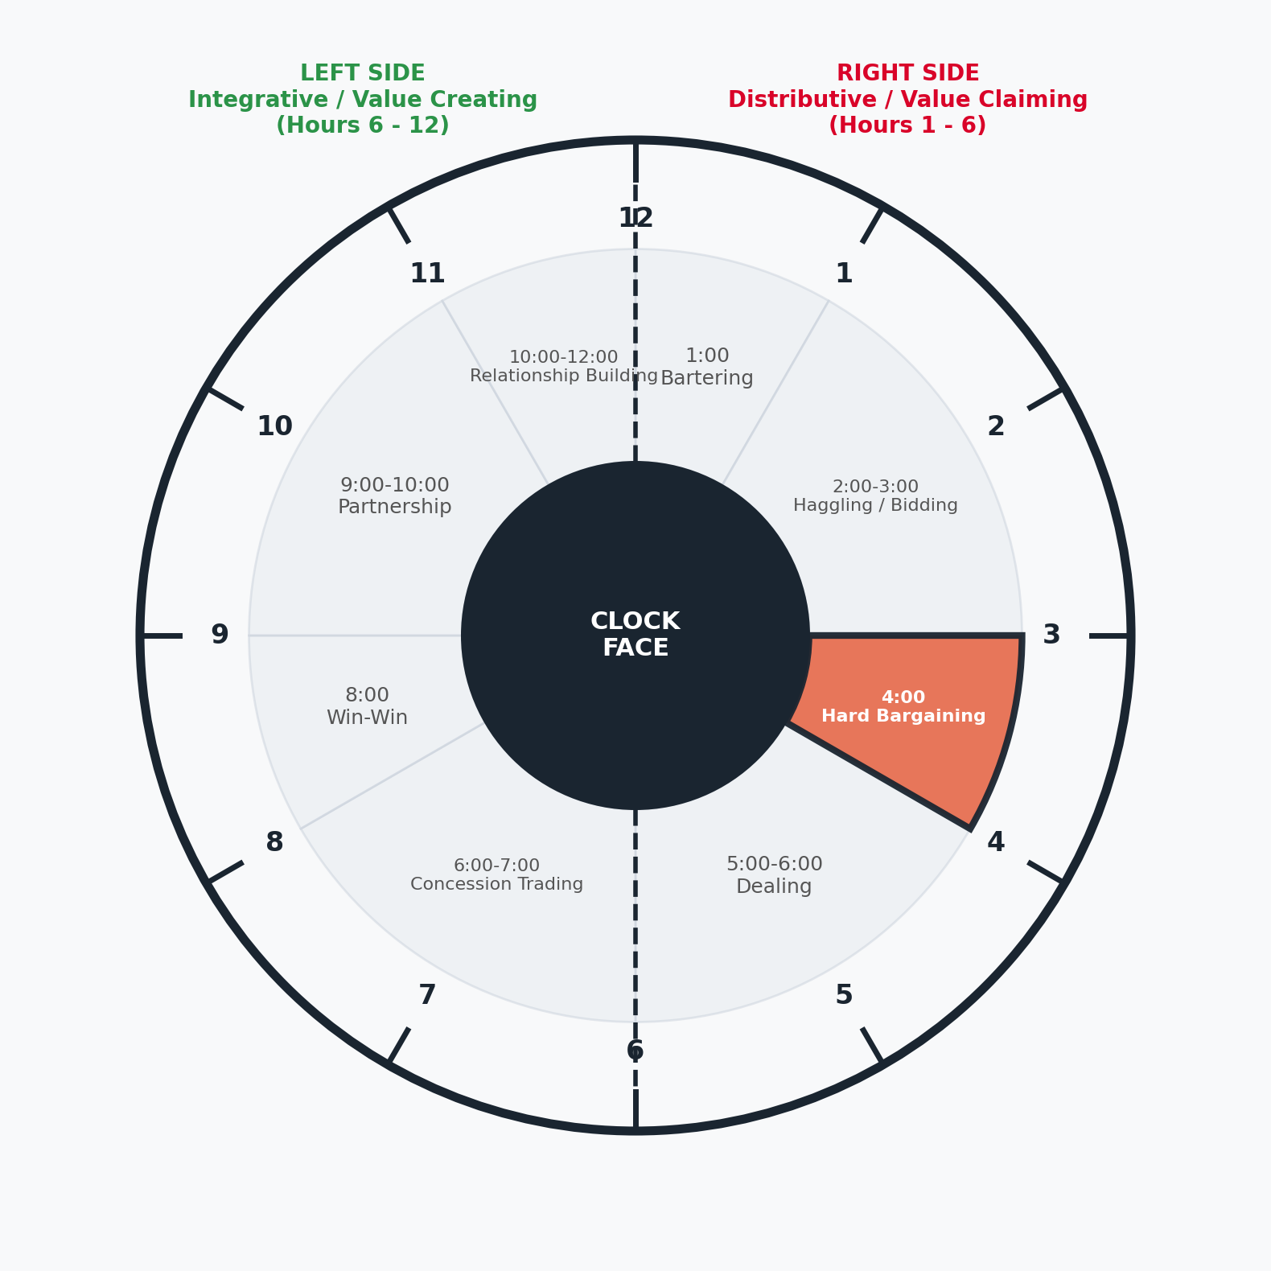
CHAPTER 3: THE NEGOTIATION CLOCK FACE
Hour 4:00 — Hard Bargaining (Positional & Price Focus)
Key Characteristics & Strategic Action
► Hour Definition & Action: Tough zero-sum bargaining over a single remaining variable (usually unit price or final M&A contract terms).
► Bargaining Range Dynamics: Navigating the space between the Buyer's Break Point (max price) and Seller's Break Point (min price).
► Core Disciplines: Delivering extreme yet realistic opening anchors, professional flinches, managing discomfort, and active use of silence.
► Strategic Art: Asking probing questions to discover the counterpart's true break point — 'negotiating from inside their head'.

Slide 6
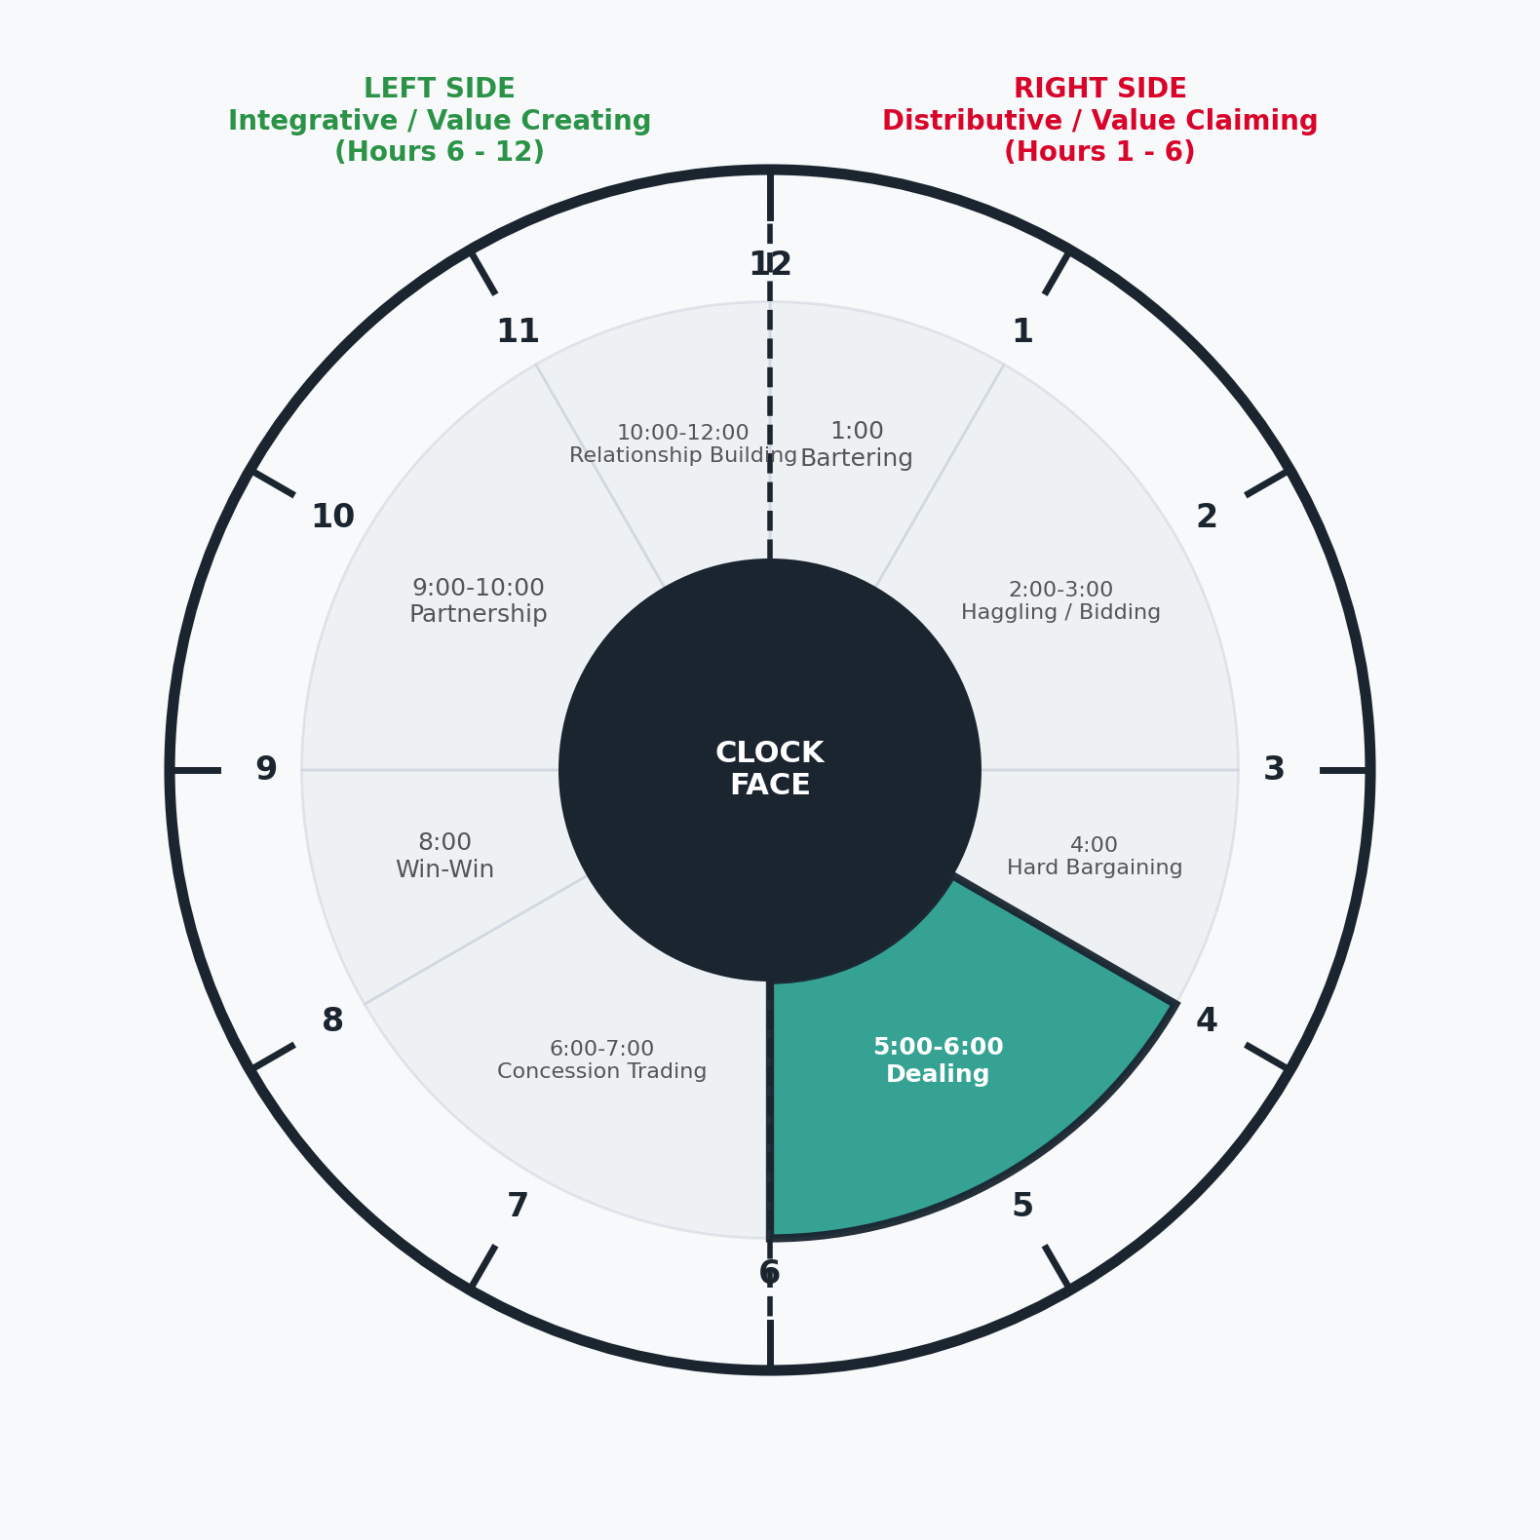
CHAPTER 3: THE NEGOTIATION CLOCK FACE
Hours 5:00–6:00 — Dealing (Time-Sensitive Value Protection)
Key Characteristics & Strategic Action
► Hour Definition & Action: Finalizing contract terms under strict deadlines (quarter-end, bonus targets, policy expiry dates).
► Value Dynamic: Trades focus on necessary moves to make the deal work rather than creating new incremental value.
► Negotiation Climate: Firm, considered, and respectful trade-offs across 3–4 transparent contractual variables.
► Key Rule: Maintaining strict conditional discipline to protect profit margins when time pressure mounts.

Slide 7
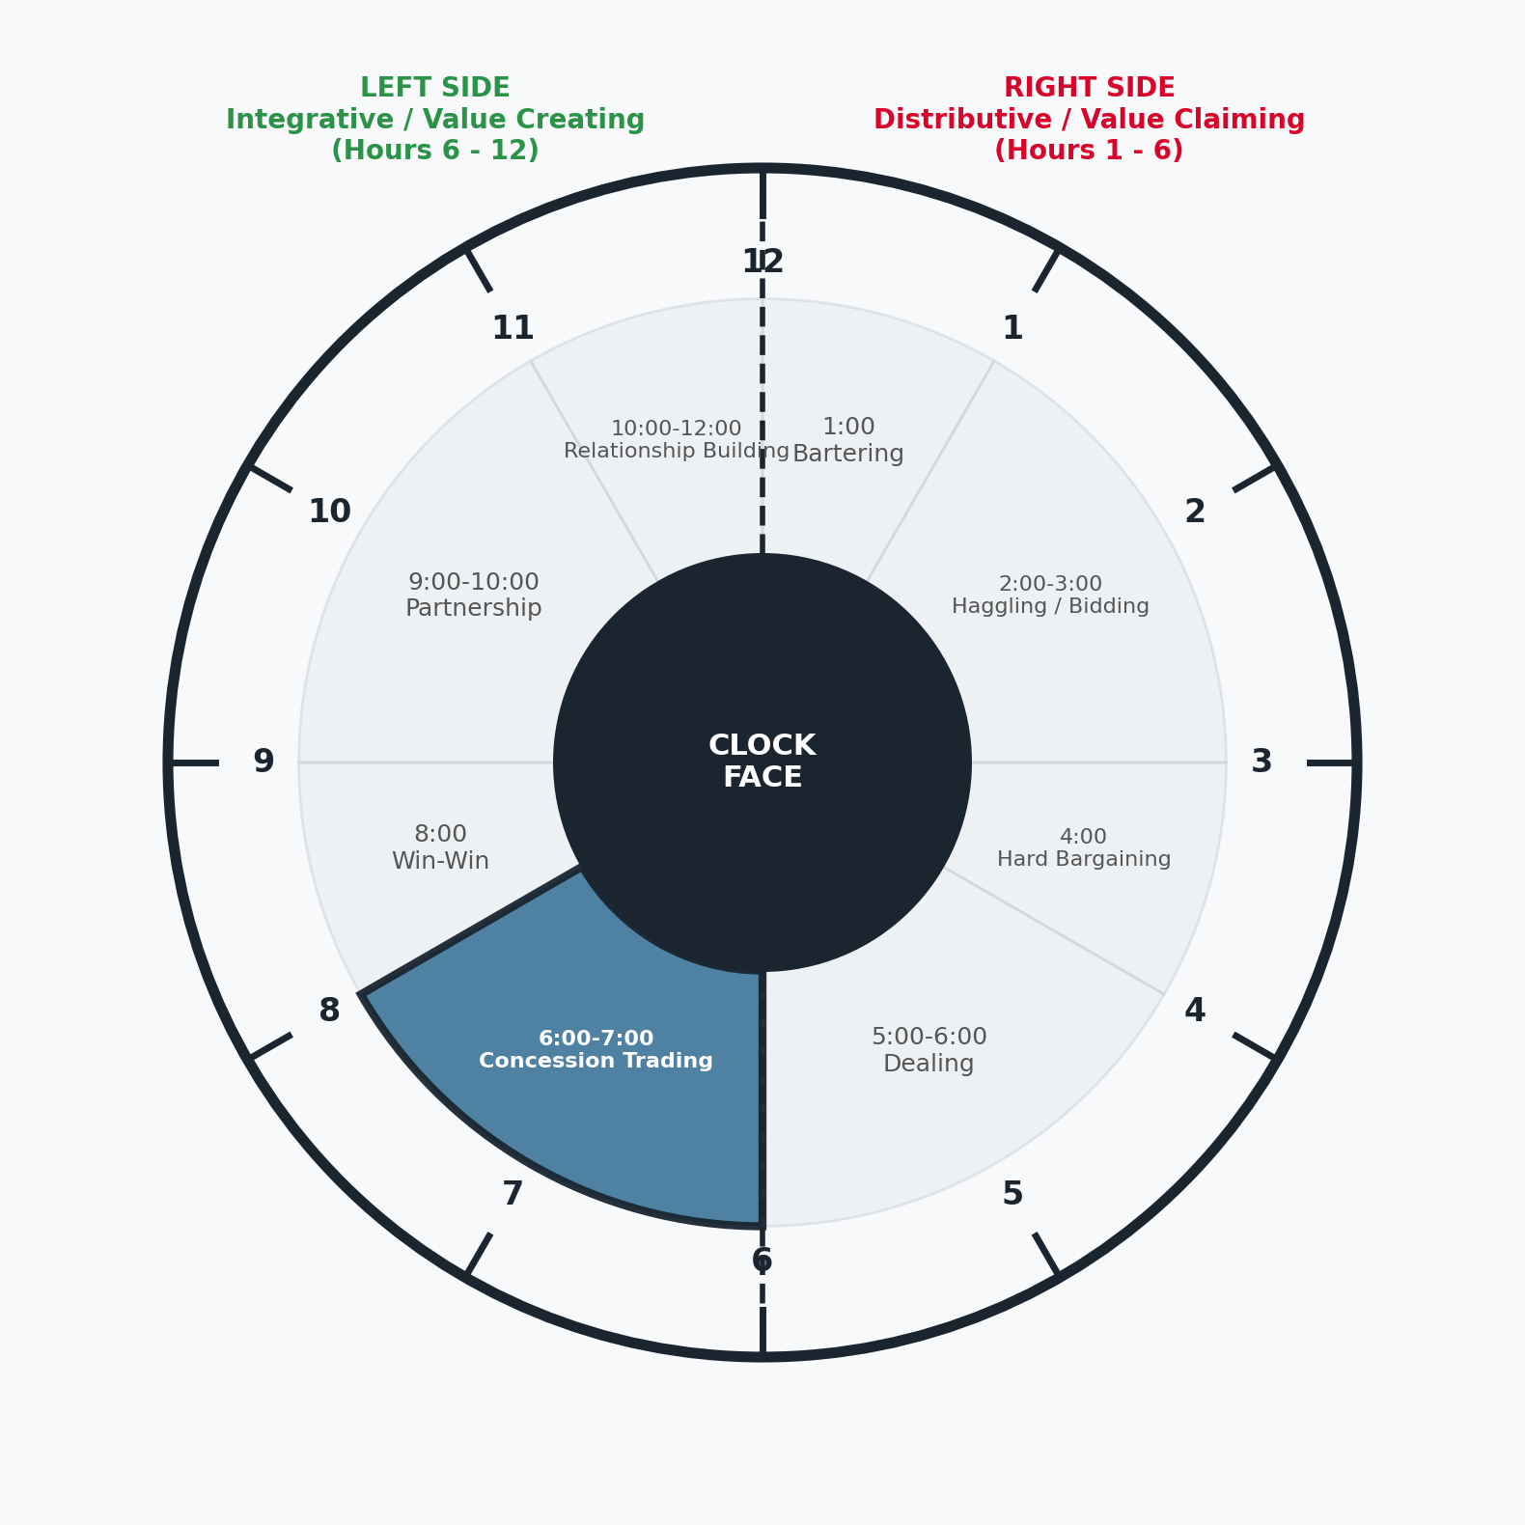
CHAPTER 3: THE NEGOTIATION CLOCK FACE
Hours 6:00–7:00 — Concession Trading (Transition to Collaboration)
Key Characteristics & Strategic Action
► Hour Definition & Action: Entering the collaborative left side of the clock through structured, mutual concession trading.
► The Golden Rule: Always execute Conditional Proposals: 'IF YOU [condition]... THEN WE [concession]...'
► Strategic Principle: 'Nothing is agreed until everything is agreed' — parking unresolved items while building total deal momentum.
► Satisfaction Management: Granting low-cost concessions that carry high perceived value to leave the counterpart satisfied with a 'good deal'.

Slide 8
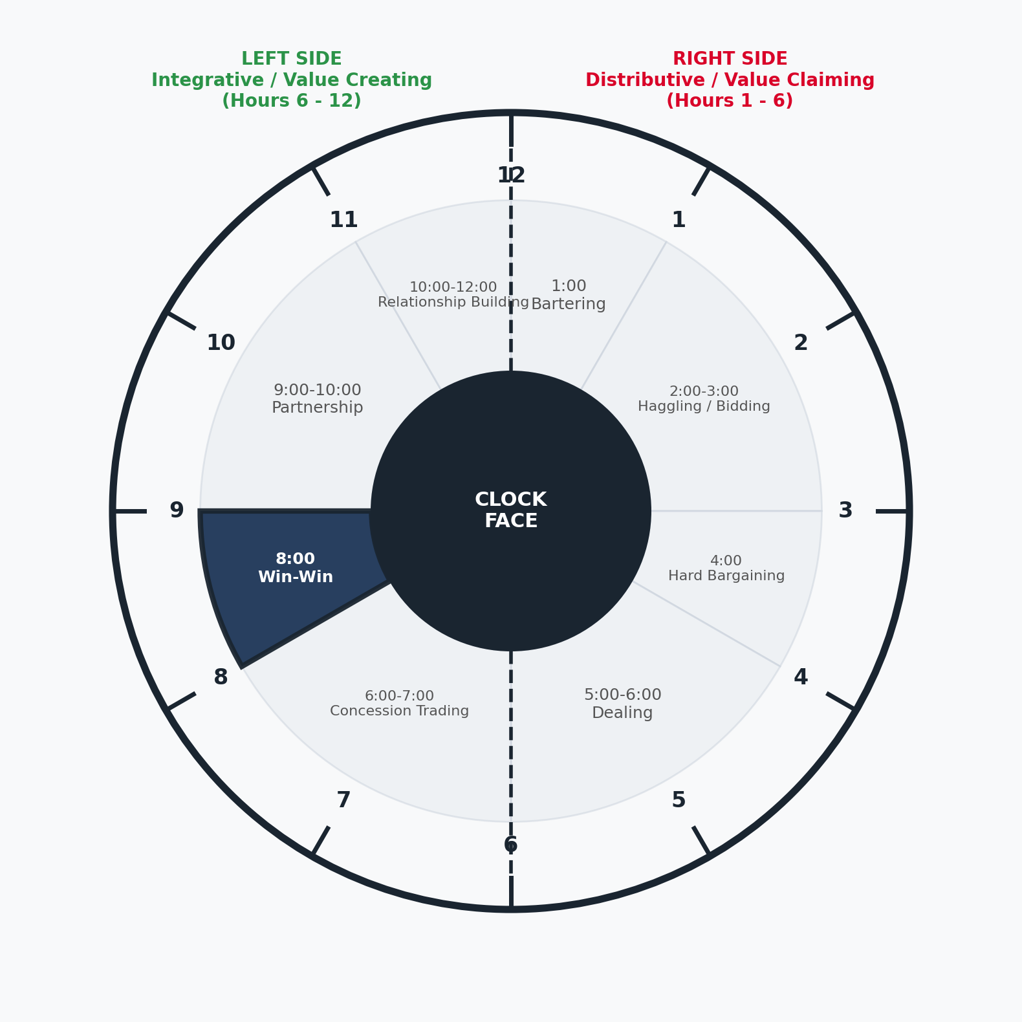
CHAPTER 3: THE NEGOTIATION CLOCK FACE
Hour 8:00 — Win-Win Negotiation (Expanding Total Contract Value)
Key Characteristics & Strategic Action
► Hour Definition & Action: Integrative bargaining that trades low-cost, high-value non-price variables to expand the total contract value ('the pie').
► Variable Engineering: Adjusting payment terms, volume thresholds, delivery schedules, exclusivity, and service guarantees.
► Corporate Case Example: Facebook's Instant Articles partnership with news publishers (BBC, NYT) sharing 100% ad revenue for platform exclusivity.
► Required Climate: Controlled information sharing built on mutual trust and aligned commercial objectives.

Slide 9
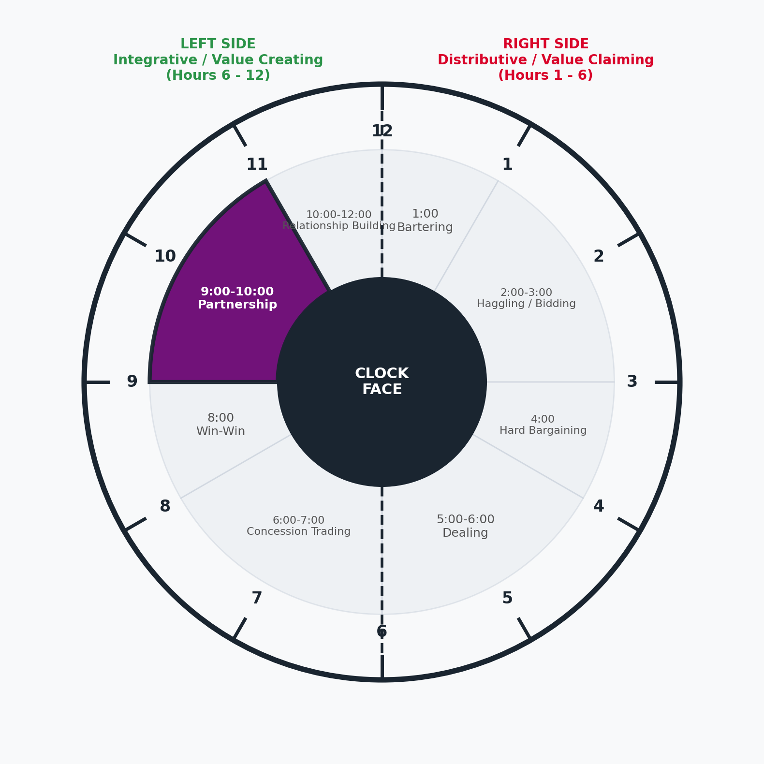
CHAPTER 3: THE NEGOTIATION CLOCK FACE
Hours 9:00–10:00 — Partnership & Joint Problem Solving
Key Characteristics & Strategic Action
► Hour Definition & Action: Deep collaborative problem-solving across complex, multi-variable strategic agendas.
► Structural Characteristics: High trust, mutual transparency, shared commercial risks, and co-developed solutions.
► Strategic Scope: Joint R&D investments, long-term supply chain integration, and shared infrastructure platforms.
► Mindset Shift: Moving from zero-sum competition to 'consultant-style' joint value optimization.

Slide 10
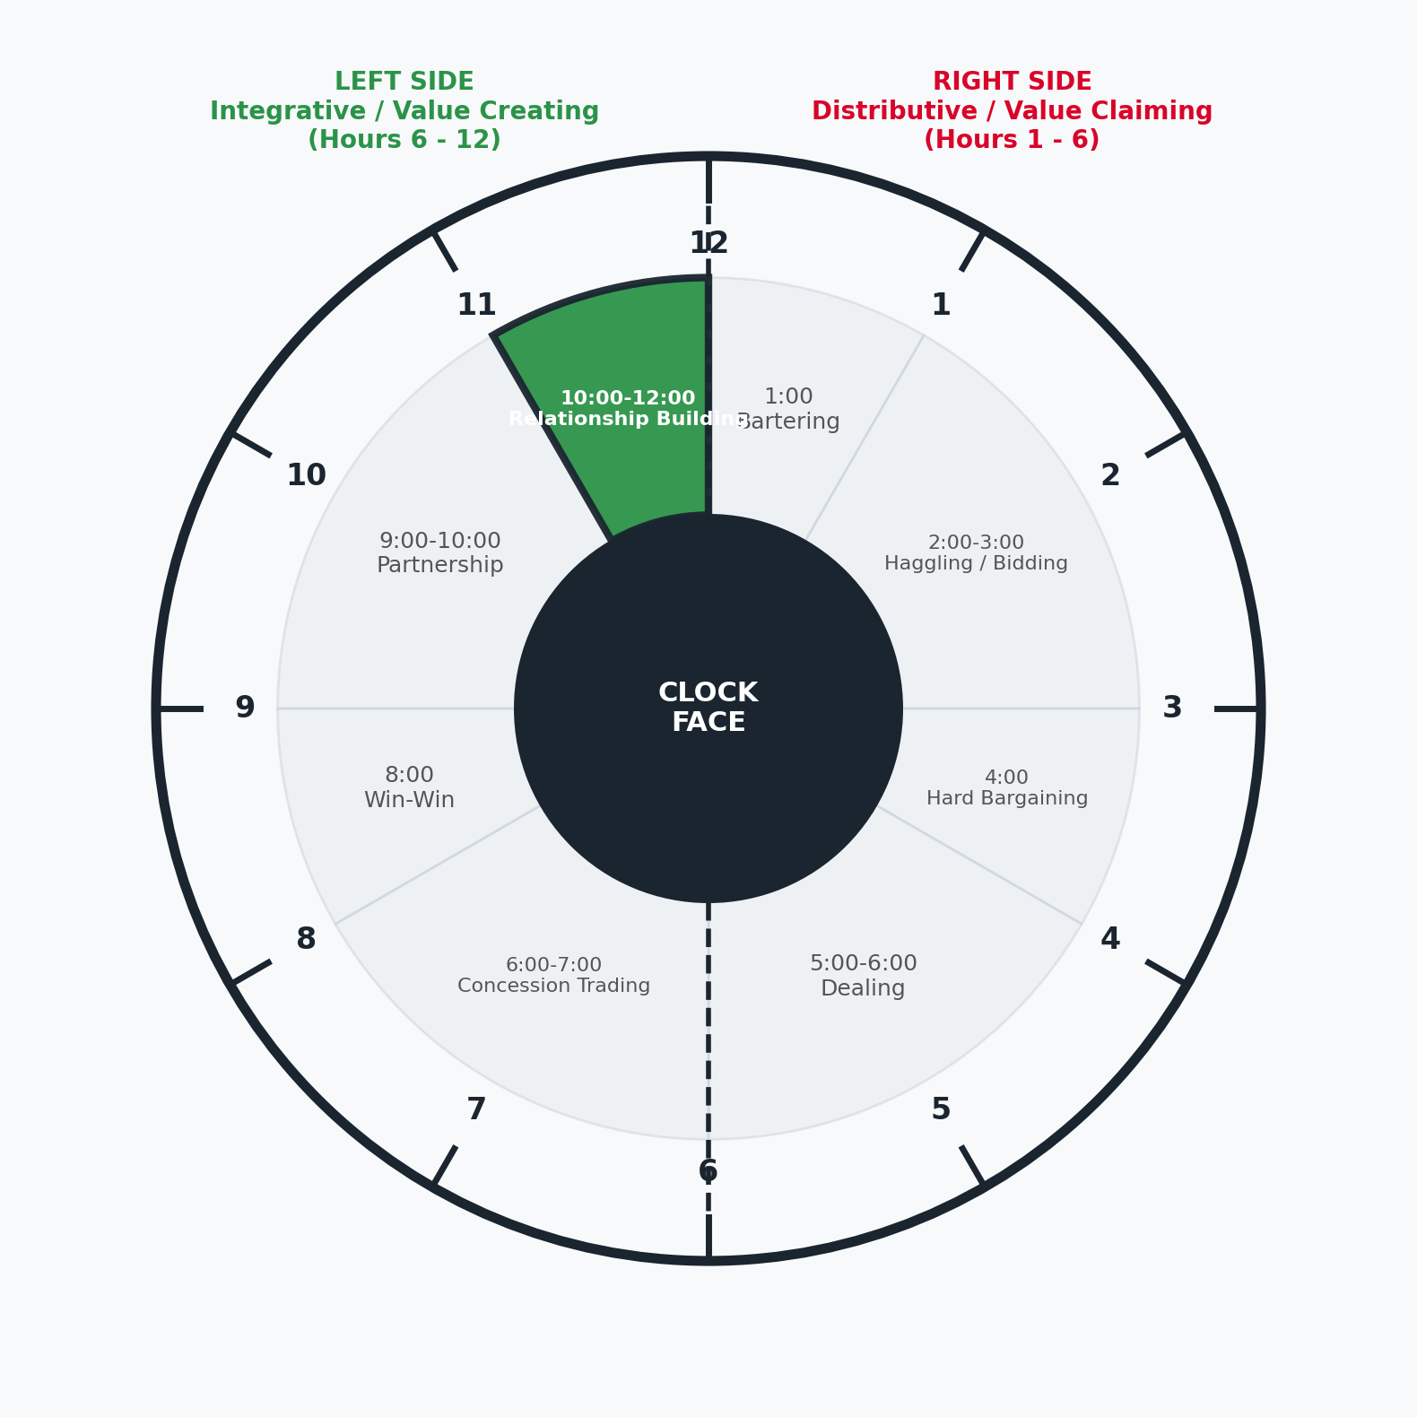
CHAPTER 3: THE NEGOTIATION CLOCK FACE
Hours 10:00–12:00 — Relationship Building & Alignment
Key Characteristics & Strategic Action
► Hour Definition & Action: Managing long-term strategic interdependence and institutional relationship governance.
► Focus Areas: Sustaining trust, intangible benefits, risk reduction, and executive-level organizational alignment.
► Adaptability in Shock: Re-evaluating terms when market disruptions occur to safeguard mutual long-term commercial viability.
► Ultimate Goal: Total organizational alignment where both entities function as interdependent strategic partners.

Slide 11
CHAPTER 3: THE NEGOTIATION CLOCK FACE
Distributive (Right Side) vs. Integrative (Left Side) Dynamics
Strategic Dimension | Right Side: Distributive (Hours 1 - 6) | Left Side: Integrative (Hours 6 - 12)
Primary Objective | Value Distribution: Claiming a fixed pie | Value Creation: Expanding the total pie
Relationship Scope | Short-term, transactional, low interdependence | Long-term, strategic, high interdependence
Information Sharing | Guarded, strategic control, positional leverage | Transparent, collaborative, exploratory dialog
Variable Focus | Single variable focus (usually unit price) | Multi-variable engineering (terms, volume, risk)
Negotiation Mindset | Competitive (Win-Lose / Positional) | Collaborative Problem-Solving (Win-Win)

Slide 12
CHAPTER 3: THE NEGOTIATION CLOCK FACE
Executive Takeaways: Strategic Rules for Skilled Negotiators
RULE 01: DIAGNOSE CLOCK POSITION
Determine where your negotiation sits on the clock face before entering discussions. Adapt your mindset to fit the actual circumstances.
RULE 02: ADAPT TO HARDENING CLIMATES
Recognize when discussions move rightward (Hours 1-6) under competitive power pressure, and adjust bargaining disciplines accordingly.
RULE 03: PROTECT LEFT-SIDE RELATIONSHIPS
When long-term dependency exists, actively guide discussions toward Hours 6-12 using multi-variable trading and trust building.
RULE 04: ENFORCE CONDITIONAL DISCIPLINE
Never grant unconditional concessions. Always execute 'IF YOU... THEN WE...' to maintain total deal value and mutual satisfaction.

