Slide 2
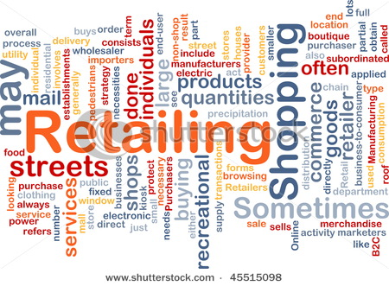

Slide 3
What is retailing?

Slide 4
What is Retailing?
Retail involves the sale of goods from a single point (malls, markets, department stores etc) directly to the consumer in small quantities for his end use.

Slide 5
Major Retailing Types
Specialty Store
Department Store
Supermarket
Convenience Store
Discount Store
Off-Price Retailer
Superstone
Catalog Showroom

Slide 6
Specialty Store
Specialty stores are small stores which specialize in
a specific range of merchandise and related items.

Slide 7
Department Store
A department store is a retail establishment which satisfies
a wide range of durable goods and products to the
consumer's personal and residential needs.

Slide 8
Supermarket
A supermarket, a form of grocery store, is a self-service store offering
a wide variety of food and household merchandise, organized into
departments.

Slide 9
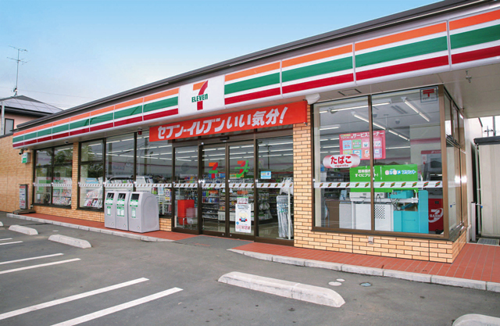
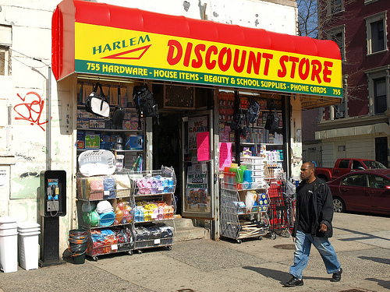
Convenience Store is a small
store or shop in a built up
area that stocks a range of
everyday items such as
groceries,alcoholic and soft
drinks, newspapers and may
also offer money order and
wire transfer services.
Discount Store is which sells
products at prices lower than
those asked by traditional
retail outlets.

Slide 10
Off-Price Retailer
Superstone
Off-price retailers sell clothing and accessories from major-label brands at a significant discount.
Huge selling space, routinely purchased food and household items, plus services (laundry, shoe repair, dry cleaning, check cashing).

Slide 11
Catalog Showroom
Catalog Showroom is a form of retailing. The typical merchant sells a wide variety of household and personal products, with many emphasizing jewelry.

Slide 12
Levels of Retail Service
Self-Service
Self-Selection
Limited Service
Full Service

Slide 13
Self-Service
Self service is the practice of serving oneself, usually when purchasing items.
Self-service is the cornerstone of all discount operations. Many customers are willing to carry out their own locate-compare-select process to save money.

Slide 14
Self-Selection
Customers find their own goods, although they can ask for assistance .
Limited Service
These retailers carry more shopping goods, and
customers need more information and assistance. The stores also offer services (such as credit and merchandise-return privileges).

Slide 15
Full Service
Full service is a term that has many different uses. In general, the term implies that customers will receive the most attentive service or have access to the greatest number of services commonly offered.

Slide 16
Non-Store Retailing
Direct Selling
Direct Marketing
Automatic Vending
Buying Service

Slide 17
Direct selling
Direct selling is the sale of a consumer product or service, person-to-person, away from a fixed retail location, marketed through independent sales representatives who are sometimes also referred to as consultants, distributors or other titles. Direct sellers are not employees of the company. They are independent contractors who market and sell the products or services of a company in return for a commission on those sales.

Slide 18
Direct Marketing
Direct marketing is a sometimes controversial sales
method by which advertisers approach potential
customers directly with products or services. The most common forms of direct marketing are telephone sales, solicited or unsolicited emails, catalogs ,brochures and coupons.

Slide 19
Automatic Vending
A vending machine is a machine which dispenses items
such as snacks, beverages, alcohol, cigarettes, lottery
tickets, consumer products and even gold and gems to customers automatically, after the customer inserts currency or credit into the machine.
Buying Service
Buying service is a storeless retailer serving a specific
clientele—usually employees of large organizations—
Who are entitled to buy from a list of retailers that have
agreed to give discounts in return for membership.

Slide 20
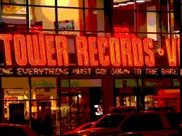
MAJOR TYPES OF CORPORATE RETAIL ORGANIZATIONS
Corporate Chain Store:One of the types of retail organizations where two or more outlets commonly owned and controlled,employing central buying and merchandising,and selling similar lines of merchandise.Examples;GAP,Pottery Barn,Hold Everything,Tower Records.

Slide 21
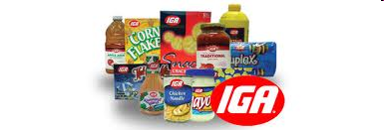
Voluntary Chain:A valuntary association of independent retailers in a given line of business for collective action in buying,advertising,and other phases of management.For instance;Independent Grocers Alliance(IGA)

Slide 22
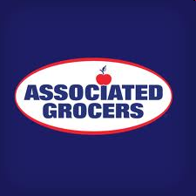
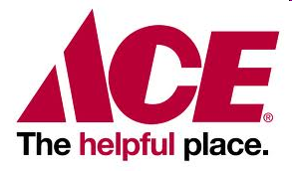
Retailer Cooperative:An organization for the collective purchase and sale of goods by a group who share profits or benefits.Examples;Associated Grocers,ACE Harware

Slide 23
Consumer Cooperative:A consumers’ cooperative is a business owned by its custemers.Employees can also generally become members.
Consumer cooperative system helps to reduce the cost of the goods by eliminating the middleman’s profit.For examples;Local Consumer Cooperatives.

Slide 24
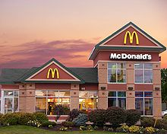
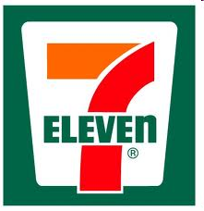
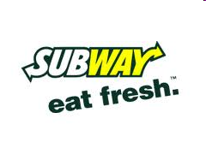
Franchise Organization:Contractual association between a franchiser and franchisees,popular in a number of product and service areas.For instance;McDonald’s,Subway,Pizza Hut,7-Eleven and etc.

Slide 25
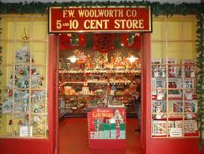
Merchandising Conglomerate:A free-form corporation that combines several diversified retailing lines&forms under central ownership,along with some integration of their distribution &management function.Examples:F.W. Woolworth,Kids Mart.

Slide 26
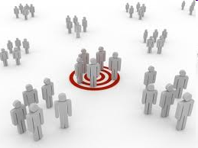
RETAILERS’ MARKETING DECISIONS
Target Market:A specific groups of consumers at which a company aims its products and services. Target marketing can be the key to a small business’s success.

Slide 27
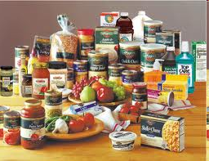
Product Assortment:The collection of goods or services that a business provides to consumers. Product assortment usually refers to the length (the number of products in the product line), breadth (the number of product lines that a company offers), depth (the different varieties of product in the product line), and consistency (the relationship between products in their final destination) of product lines.

Slide 28
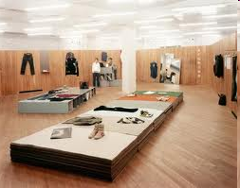
Store Atmosphere is another element in the store arsenal.Every store has a look and a physical layout that makes it hard or easy to move around.

Slide 29
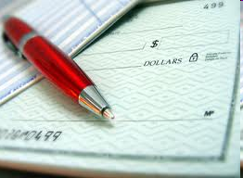
Procurement:The process of obtaining goods and services from preparation and processing of a requisition through to receipt and approval of the invoice for payment.

Slide 30
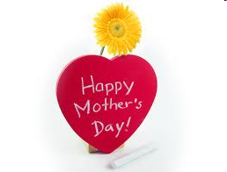
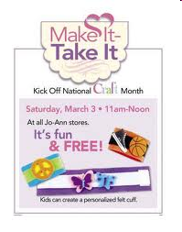
Store Activities:The growth of e-commerce has forced traditional brick-and-mortar retailers to respond.In addition to their natural advantages,such as products that shoppes can actually see,touch,and test,real-life customer service,and no delivery lag time for small or medium-sized purchases.

Slide 31
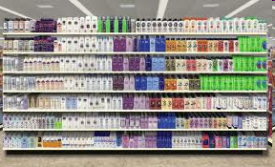
RETAIL CATEGORY MANAGEMENT
Cotegory Management is a process that involves managing product categories as business units and customizing them to satisfy customer needs.

Slide 32
The industry standard model for category management is the 8-steps process:
1.Define the category
2.Define the role of the category within the retailer
3.Assess the current performance
4.Set goals

Slide 33
5.Choose the audience
6.Devise specific tactics
7.Implementation
8.The eight step is one of review which takes us back to step 1

Slide 34
Retailer Services
Prepurchase services
Postpurchase services
Ancillary services

Slide 35
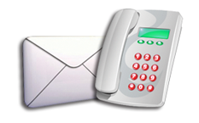
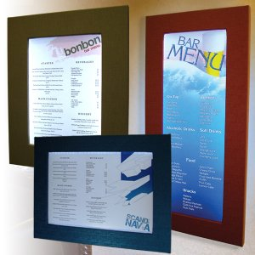
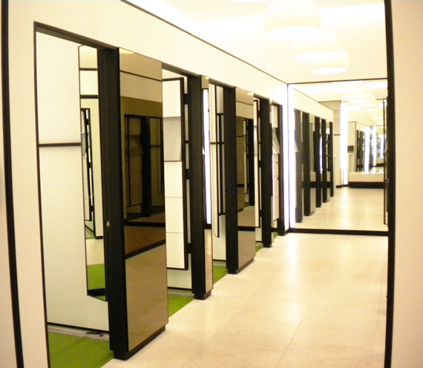
Prepurchase services
Prepurchase services include accepting telephone and mail orders, advertising, window and interior display, fitting rooms, shopping hours.

Slide 36
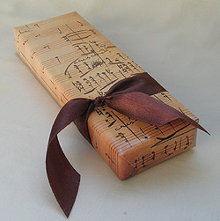
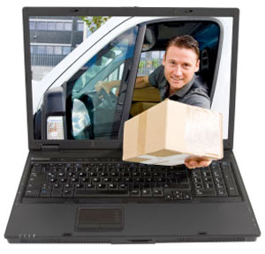
Postpurchase services
Postpurchase services include shipping and delivery, gift wrapping, adjustments and returns, alterations and tailoring, installations, engraving.

Slide 37
Ancillary services
Ancillary services include general information, check cashing, parking, restaurants, repairs, interior decorating, credit, rest rooms, baby-attendant service.

